Slide 1

RAJEEV INSTITUTE OF TECHNOLOGY
COMPUTER SCIENCE & ENGINEERING
Technical seminar on
GESTURE RECOGNITION
Under the guidance of,
Mrs. Sangeetha S
Assistant Professor
Dept. Of CSE
RIT, Hassan
Presented by,
Uzair Ahmed 4RA16CS102

Slide 2
What is Gesture Recognition?
Gesture recognition is a topic in computer science and language technology with the goal of interpreting human gestures via mathematical algorithms.
In gesture recognition technology, a device reads the movements of the human body and communicates the data to a computer that uses the gestures as input to control devices or applications.
Mostly Gesture recognition means enabling humans to communicate with the machine and interact naturally without any mechanical devices.
But some times sensors attached to a device such as a data glove is also used for more precession

Slide 3
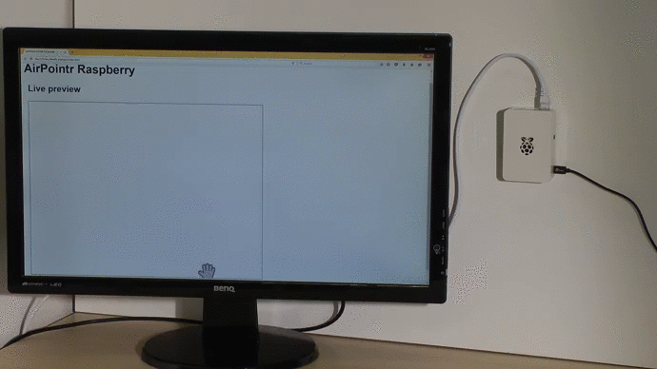
In addition to hand and body movement, gesture recognition technology also can be used to read facial and speech expressions (i.e., lip reading), and eye movements.
Using the concept of gesture recognition, it is possible to point a finger at the computer screen that the cursor will move accordingly. For example, a person waving his hand front of a camera to draw a shape like circle when the gesture is fed through a computer.

Slide 4
Gesture Types
In computer interfaces, two types of gestures are distinguished:
Offline gestures:
Those gestures that are processed after the user interaction with the object. An example is the gesture to activate a menu or draw a circle
Online (real time) gestures:
Direct manipulation gestures. They are used to scale or rotate a tangible object.

Slide 5
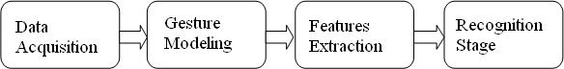
Gesture Recognition System
Collects the input data
Fitting and fusing the input gesture into the template model used
Uses the recognition algorithm to find out the gesture
The command/meaning of the gesture should be declared and carried out

Slide 6
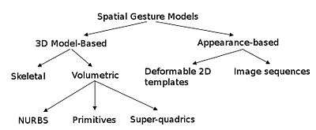
Algorithms
Depending on the type of the input data, the approach for interpreting a gesture could be done in different ways.
Some literature differentiates two different approaches in gesture recognition.
3D model based
Appearance-based.

Slide 7
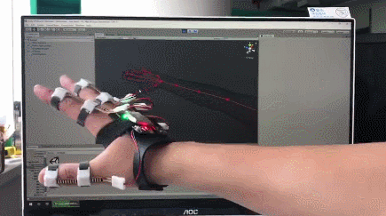
3D model-based
The 3D model approach can use volumetric or skeletal models, or even a combination of the two. The models are generally created of complicated 3D surfaces, like NURBS or polygon meshes.
The drawback of this method is that is very computational intensive, and systems for live analysis are still to be developed.

Slide 8
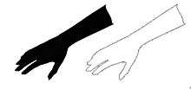
Appearance based
These models don’t use a spatial representation of the body instead use deformable templates.
They derive the parameters directly from the images or videos using image processing and a template database.
Deformable templates are sets of points on the outline of an object, used as interpolation nodes for the object’s outline approximation.

Slide 9
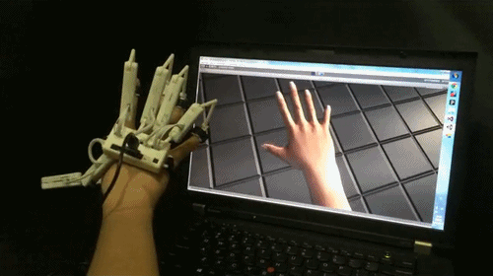
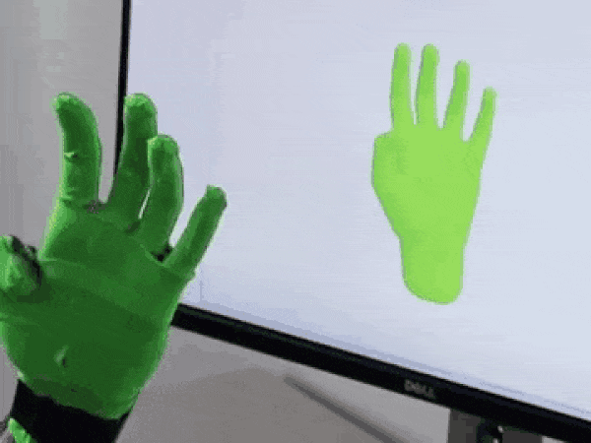
Input Devices
Wired gloves: These can provide input to the computer about the position and rotation of the hands using magnetic or inertial tracking devices

Slide 10
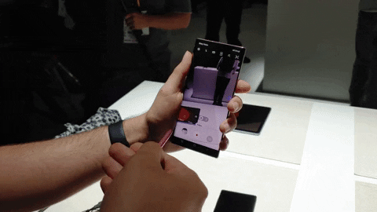
Controller based gestures: These controllers act as an extension of the body so that when gestures are performed, some of their motion can be conveniently captured by software. Eg Wii Remote, which can study changes in acceleration over time to represent gestures.

Slide 11
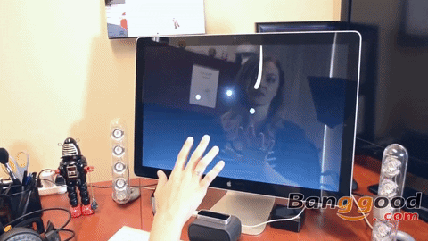
Camera systems: A single standard 2D camera can be used for gesture recognition where it uses image processing based software to recognise data.
Depth-aware cameras: These are specialized cameras such as structured light or time-of-flight cameras, one can generate a depth map and use this data to approximate a 3d representation.
Stereo cameras: Uses two cameras whose relations to one another are known, a 3d representation can be approximated by the output of the cameras.

Slide 12
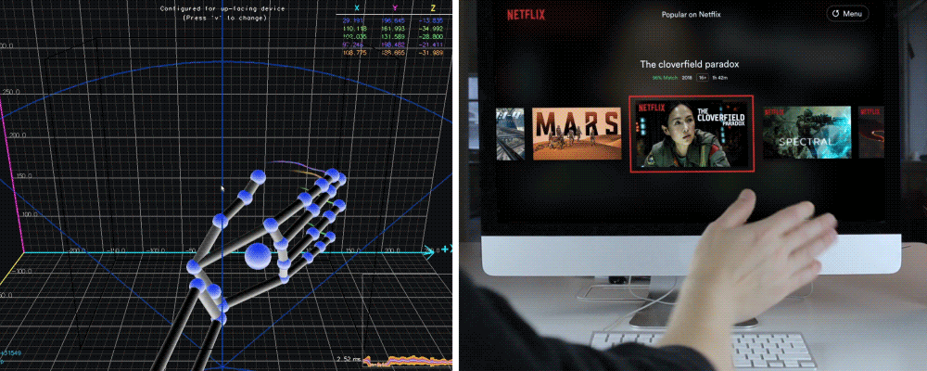
Radar: The basic function of radar is to detect and measure properties of objects based on their interactions with radio waves. Based on the received waveforms, the radar system can detect the presence of objects as well as estimate certain properties of these objects, such as distance and size.

Slide 13
Uses of Gesture Recognition
Controlling through facial gestures: Controlling a computer through facial gestures is a useful for users who may not physically be able to use a mouse or keyboard. Eye Tracking in particular may be of use for controlling cursor motion or focusing on elements of a display.
Alternative computer interfaces: Foregoing the traditional keyboard and mouse setup to interact with a computer, strong gesture recognition could allow users to accomplish frequent or common tasks using hand or face gestures to a camera.

Slide 14
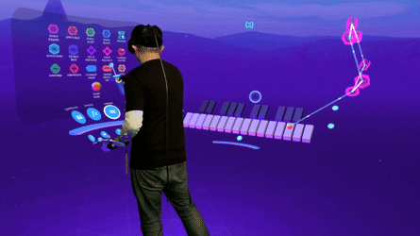
Immersive game technology: Gestures can be used to control interactions within video games to try and make the game player's experience more interactive or immersive.
Virtual controllers: For systems where the act of finding or acquiring a physical controller could require too much time, gestures can be used as an alternative control mechanism.

Slide 15
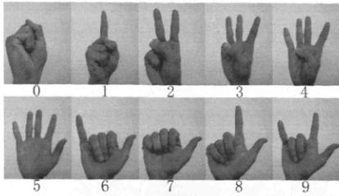
Sing language recognition: Just as speech recognition can transcribe speech to text, certain types of gesture recognition software can transcribe the symbols represented through sign language into text.

Slide 16
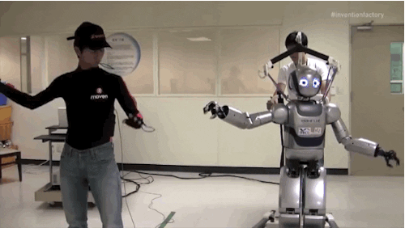
For training and controlling socially assistive robotics: By using proper sensors (accelerometers and gyros) worn on the body of a patient and by reading the values from those sensors, robots can assist in patient rehabilitation.

Slide 17
Thank you

